Slide 1

Enhancing Security in Telehealth Informatics
Amulya Rangineni

Slide 2

Problem
Have you ever considered the hidden dangers in telehealth informatics?
In the Telehealth field, patient information faces significant risks during transmission. Unauthorized access to records and inadequate data encryption highlight the gravity of this problem, risking patient privacy and straining regulatory compliance. These breaches not only jeopardize data security but also erode trust in healthcare relationships. Pinpointing vulnerabilities at handover points emphasizes the critical nature of the issue, urging immediate action. Aligning data security with regulations is crucial for fostering trust and safeguarding sensitive information.

Slide 3
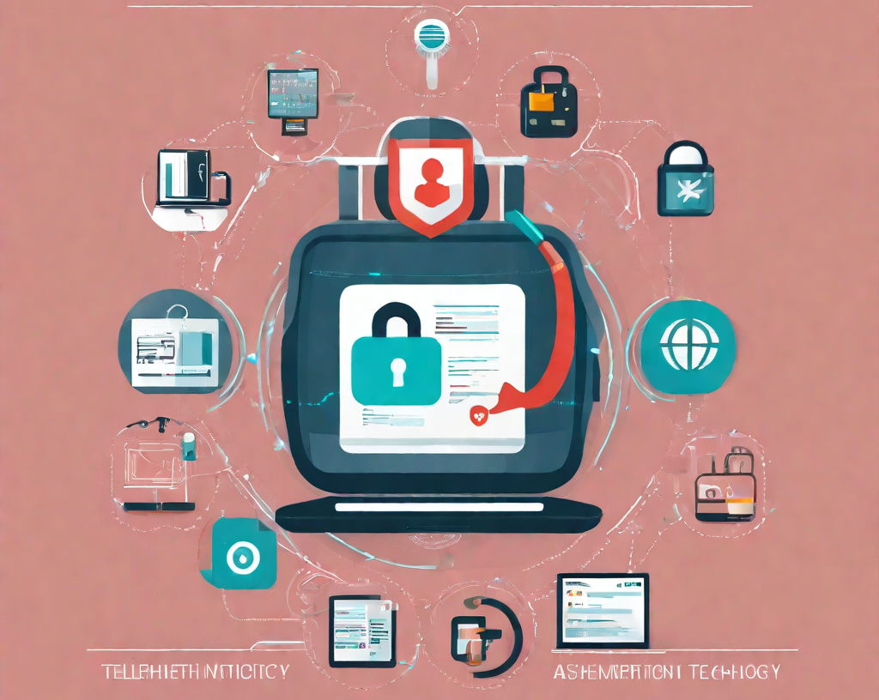
Solution
Our solution focuses on a fortified two-factor authentication and encryption system tailored for telehealth, aiming to significantly reduce data breaches. As I delved into this, what I discovered was that this solution is centered on a robust security system named two-factor authentication and encryption. This system is custom-made for telehealth to effectively minimize data breaches. We intentionally chose this because it aligns with security standards across various industries and proves adaptable in the intricate realm of healthcare.

Slide 4

Validation
To validate our solution effectively, we require a comprehensive understanding of several key aspects:
Technological Infrastructure: Insights that bolster technical requirements for successful implementation.
Training and Policy Requirements: Understanding necessary training and policy adaptations crucial for effective deployment.
Effectiveness Metrics: Metrics outlined to gauge the system's success in preventing breaches.

Slide 5

Plan for Validating or Testing the Solution
Our structured methodology for validation encompasses:
In-depth delineation of problem intricacies, identifying critical variables.
Establishment of measurable metrics to provide a quantifiable evaluation basis.
Comprehensive gathering and analysis of data to ensure exhaustive scrutiny and validation.

Slide 6

Thank You

